Slide 1

Practice Management/Project Management Project Delivery Types
ORB University - Mini

Slide 2
Project Delivery Methods
Design-Bid-Build
Design-Build
Design-Negotiate Build
Cost-Plus Fixed Fee
Construction Manager – As Advisor
Construction Manager – At Risk
Construction Manager – As Agent
Integrated Project Delivery - IPD

Slide 3
What is Project Delivery?
Manner in which the owner contracts for design and construction services.
Why? – Advise clients on potential delivery methods or understand their preferred method.
Effects:
Contract Roles
Schedule – Different Phases of Design and Construction
Risk
Fees
Final Project Outcome

Slide 4
TRADITIONAL

Slide 5
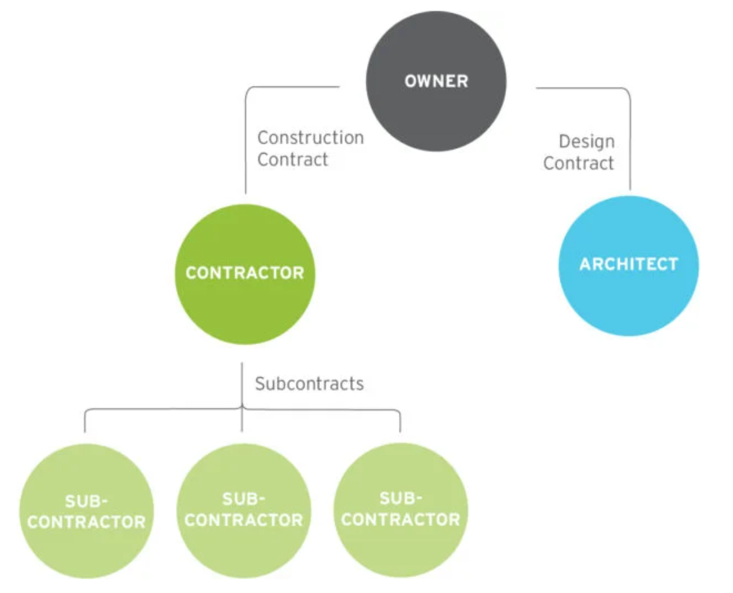
TRADITIONAL
Design-Bid-Build (DBB)
A traditional project delivery method. This delivery method involves the design team creating a set of bid documents on which multiple contractors will enter bids, with one winning bidder ultimately being chosen to construct the work. The Owner holds a contract with the Architect and separate contract with the Contractor.

Slide 6
Design-Bid-Build (DBB)
PROS | CONS
Predictable Reduce Costs | Lowest Bids Win No early collaboration with construction – drawings will typically need to be highly detailed and complete
TRADITIONAL

Slide 7
Design-Negotiate Build (DNB)
A variant of the design-bid-build project delivery method, where instead of competitively bidding the project, the owner negotiates with a few preselected contractors and determines which is most well suited to construct the project.
Only available in privately-funded projects.
TRADITIONAL

Slide 8
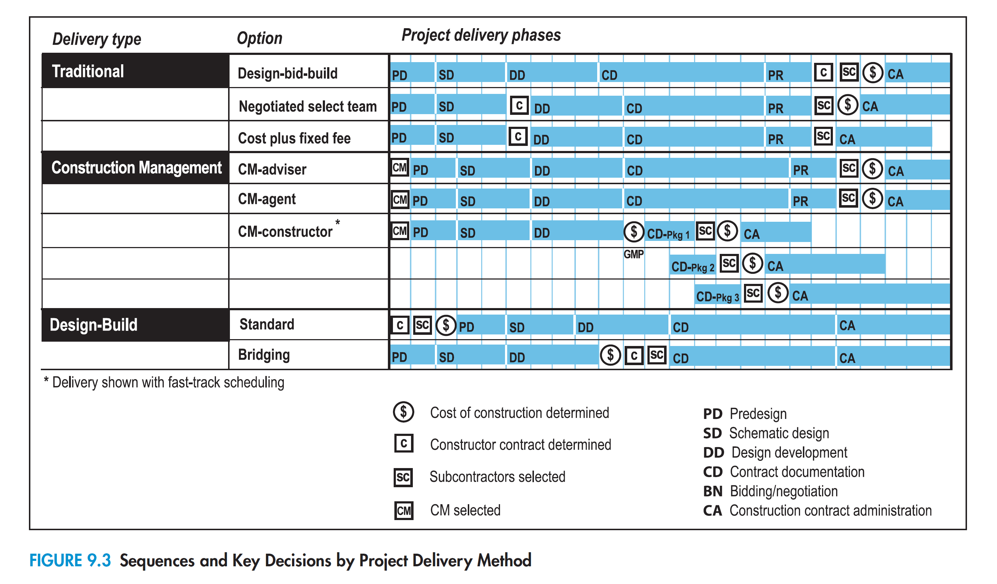

Slide 9
CONSTRUCTION MANAGEMENT

Slide 10
Construction Manager – As Advisor (CMa)
The CM as adviser acts only as a constructability and cost management consultant to the owner during the design and construction process, but will not build the building.
CONSTRUCION MANAGER

Slide 11
Construction Manager – As Advisor (CMa)
PROS | CONS
COST DECISIONS EARLY NO RISK FOR THE ADVISOR | OWNER TAKES ON MORE COST RISK
CONSTRUCION MANAGER

Slide 12
Construction Manager – As Agent (CM-A)
The CM as agent provides early consulting and may act on behalf of the owner in assembling and coordinating the construction trades prior to and during construction. CM-agents typically provide their services for a fixed fee and assume no risk for the actual construction costs themselves but pass on both savings and overruns directly to the owner.
CONSTRUCION MANAGER

Slide 13
Construction Manager – As Agent (CM-A)
PROS | CONS
COST DECISIONS EARLY LESS RISK FOR THE AGENT CONSTRUCTION MANAGER COORDINATES FOR THE OWNER UNTIL CONSTRUCTION | OWNER TAKES ON MORE COST RISK
CONSTRUCTION MANAGER

Slide 14
Construction Manager – At Risk or
Construction Manager as Constructor (CM-C)
The constructability and cost adviser role of the contractor during the project’s design phase.
CM methods of delivery frequently include the use of a “guaranteed maximum price,” or “GMP,” which is a commitment by the CM-C to build the project for a specified price based on early design documents (typically those available at the end of design development).
This places the CM-C at risk for the construction cost of the project.
Can use a fast-track method: multiple bid packages to speed up construction
CONSTRUCTION MANAGER

Slide 15
Construction Manager – At Risk or
Construction Manager as Constructor (CM-C)
PROS | CONS
COST DECISIONS EARLY LESS RISK FOR THE OWNER GREAT FOR LARGE, COMPLEX PROJECTS STRONGER GRASP OF PROJECT SCHEDULE | CONTRACTOR INCENTIVE TO REDUCE COSTS FOR HIGHER PROFITABILITY
CONSTRUCTION MANAGER

Slide 17
DESIGN-BUILD

Slide 18
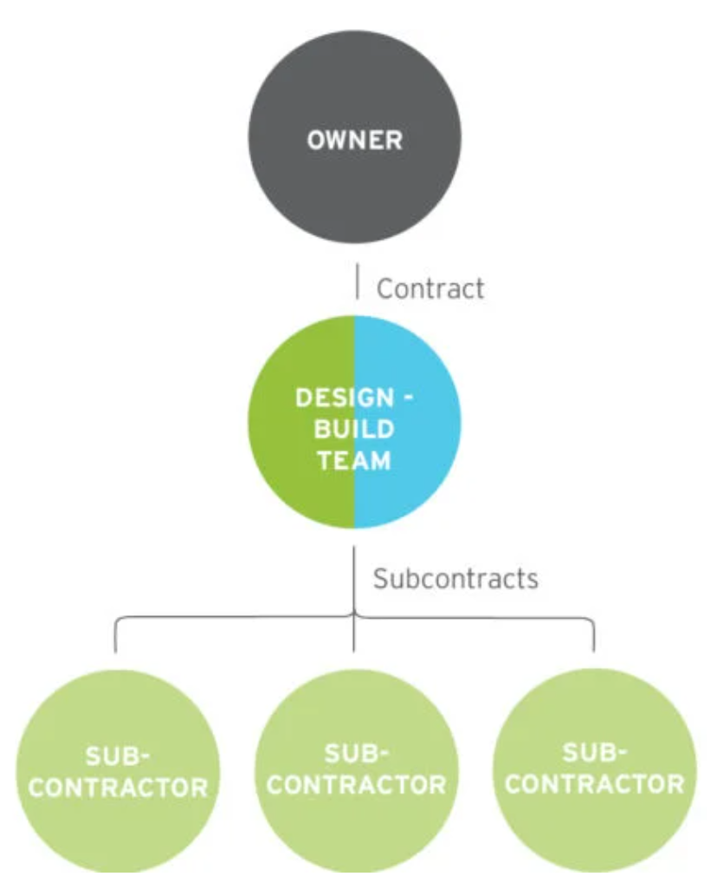
Design-Build (DB)
This delivery method provides the owner a single-point responsibility for both design and construction.
Typically, that entity is a contractor with the architect as a subconsultant for design services. This contract typically includes a fixed price for both design services and construction cost.
Can be Bridged-Design Build: Designer Architect and Production Architect later

Slide 19
Design-Build (DB)
PROS | CONS
Owner cares about quality – Bridged Design-Build Cost-efficient with early estimates Early coordination Fixed price Great for standard constructions like spec industrial and residential | Design can take a backseat to Cost with Standard DB

Slide 21
Recap
Delivery Methods – Common 2-3 categories:
Traditional
Construction Management
Design-Build
When a contractor is brought onboard:
Bid process – Design-Bid-Build, Design-Negotiate Build
Early – Construction Managers, Design-Build
Mitigating risks for Client, Architect, Contractor

Slide 22

QUIZ
1. A construction manager is hired to advise a large company during the initial design phase of a complex facility. The construction manager coordinates construction trades for the project. The construction manager's services are provided for a fixed fee, and there is no risk for final construction cost. Savings or overruns are passed to the owner.
Which construction delivery method is most applicable?
A. Construction Manager as Agent (CMa)
B. Construction Manager as Constructor (CMc)
C. Construction Manager at Risk (CMAR)
D. Construction Manager as Advisor (CM-Advisor)

Slide 23
QUIZ
1. A construction manager is hired to advise a large company during the initial design phase of a complex facility. The construction manager coordinates construction trades for the project. The construction manager's services are provided for a fixed fee, and there is no risk for final construction cost. Savings or overruns are passed to the owner.
Which construction delivery method is most applicable?
A. Construction Manager as Agent (CM-A)
B. Construction Manager as Constructor (CMc)
C. Construction Manager at Risk (CMAR)
D. Construction Manager as Advisor (CMa)

